Slide 1
Key Differences
Feature | XML-Based | Java-Based
Type Safety | Not type-safe (strings for class names, IDs, etc.) | Type-safe (uses actual Java classes and methods)
Refactoring Support | Weak (XML doesn’t update with refactor) | Strong (IDE can refactor Java code easily)
Readability | Easier for non-developers (declarative) | Easier for developers (imperative, familiar syntax)
Flexibility | Static — limited dynamic logic | Dynamic — can use loops, conditions, etc.
Dependency Injection | Declared via XML tags (<bean>, <property>) | Declared via annotations and methods (@Bean, @Autowired)
Externalization | Easy to modify without recompiling code | Requires recompilation if configuration changes
Annotation Usage | Often used with XML config (<context:component-scan>) | Pure annotation-based configuration possible
Concept | Meaning
Configuration | Instructions for Spring on how to create and manage objects (beans).
Purpose | To wire components together and set up the application context.
Types | XML-based, Java-based, and annotation-based.
Modern Practice | Java-based + annotation-based (in Spring Boot).

Slide 2
Prerequisites for this Module
Core Java Review
OOP principles (Abstraction, Inheritance, Polymorphism, Encapsulation)
Interfaces vs Abstract Classes
Packages & Access Modifiers
Exception Handling
Java Collections
Build Tools (Basic)
Maven basics,Project structure
pom.xml

Slide 3
Configuration
Definition:
Configuration means defining how the application should behave — especially how its components (or beans in Spring) are created, connected, and managed.
In simpler terms:
Configuration tells the framework what objects to create, how to connect them, and what settings to use.
Aspect | XML-Based Configuration | Java-Based Configuration
Definition Style | Beans and dependencies are defined in XML files (e.g., applicationContext.xml) | Beans and dependencies are defined using Java classes and annotations (e.g., @Configuration, @Bean)
Introduced In | Original Spring (early versions) | Spring 3.0 and later
Primary Use Case | Externalized, declarative configuration | Type-safe, code-centric configuration
Aspect | Tight Coupling (Java) | Loose Coupling (Java + Spring)
Dependency | Directly on concrete class | On interface or abstraction
Object Creation | new keyword inside class | Injected by Spring DI (@Autowired)
Flexibility | Low | High
Testability | Difficult | Easy (use mocks)
Maintenance | Hard | Easy
Example | Car car = new Engine(); | Car car = new PetrolEngine(); (injected)

Slide 4
Coupling in Java and Spring
1. What is Coupling?
Coupling in software engineering refers to the degree of dependency between classes or modules.
In Java, coupling shows how one class relies on another class to function.
In Spring Framework, coupling is minimized using Dependency Injection (DI) and Inversion of Control (IoC), which promotes modular and maintainable applications.
Goal: Reduce coupling to achieve a flexible, testable, and scalable system.
2. Tight Coupling (High Coupling)
Definition:
Tight coupling occurs when a Java class directly
depends on another concrete class.
A small change in one class can impact dependent classes.
Characteristics in Java:
Direct object creation using new.
Hard-coded dependencies.
Low flexibility and reusability.
Difficult to unit test.
Hard to change or extend functionality.
Low testability (cannot mock Engine easily).
Code is rigid and less reusable.
Spring Perspective:
Spring discourages tight coupling because it reduces flexibility and makes testing difficult.

Slide 5
Loose Coupling (Low Coupling)
Definition:
Loose coupling occurs when a class depends on abstractions (interfaces) rather than concrete implementations.
Characteristics in Java:
Depend on interfaces or abstract classes.
Use Dependency Injection (DI) to provide objects.
Improves testability, maintainability, and reusability.
Spring Features Enabling Loose Coupling:
Dependency Injection (DI): Injects required dependencies rather than creating them in the class.
Inversion of Control (IoC): Spring manages object creation and wiring.
Use of Interfaces and Abstraction: Promotes modular design.
Annotations and Configuration: @Autowired, @Component, @Service, @Repository.
Advantages of Loose Coupling:
Flexible and easy to extend.
Promotes modular design.
Better for unit testing (mock dependencies).
Easier maintenance and scalability.

Slide 6
Spring Syllabus
Introduction
Spring Basic (features ,application ,uses , spring project)
Spring Bean class
Spring IOC
Spring Dependency injection (setter ,constuctor ,field)
Spring Bean Scope (Singleton , Prototype, Request ,Session, Global-Session)
Spring Auto Wiring
Spring Annotations
Spring Jdbc
Spring MVC
MVC Architecture
Spring MVC Configuration With Maven Project
Spring MVC First Web Application
Spring With Restful Web Services And Mappings
Spring End.

Slide 7
what is Framework
A framework is a structured foundation of reusable code, tools, and guidelines designed to help developers build and organize software applications efficiently.
It provides predefined architecture, components, and workflows, allowing developers to focus on implementing application-specific logic rather than reinventing basic functionalities.
Why Use a Framework?
Developers use frameworks because they save time, reduce errors, and enforce best practices when building software.
A framework gives you a ready-made structure and set of tools so you don’t have to start every project from scratch.
Characteristic | Description
Reusability | Provides pre-built components to save development time.
Structure | Enforces a standard way of organizing and writing code.
Extensibility | Allows developers to add or modify components as needed.
Inversion of Control (IoC) | The framework manages execution flow, calling developer code at appropriate times.
Productivity | Accelerates development by handling common tasks (routing, authentication, database access, etc.).

Slide 8
Examples of Frameworks (with Related Technologies)
Technology Domain | Framework
Web Development (Frontend) | React.js/Angular
Web Development (Backend) | Django (Python)
Mobile App Development | Flutter (Dart)
Enterprise Java Applications | Spring Framework /Spring Boot (Java)
.NET Technology | ASP.NET Core (C# )
Machine Learning / AI | TensorFlow (Python AI)

Slide 9
Introduction to Spring Framework
Spring Framework is a powerful, lightweight, and open-source Java-based framework used to build scalable, enterprise-level applications.
It provides comprehensive infrastructure support for developing Java applications, including web apps, microservices, and APIs.
Developed by:
Initially created by Rod Johnson in 2003.
Core Idea:
Dependency Injection (DI) and Aspect-Oriented Programming (AOP) are at the heart of Spring.
Feature | Description
Lightweight | Minimal memory footprint; fast startup
Dependency Injection | Loose coupling through Inversion of Control (IoC)
Modular Architecture | Use only what you need (e.g., Spring MVC, Spring Security)
Integration Support | Easily integrates with databases, ORM (Hibernate), messaging, and more
Aspect-Oriented Programming | Helps separate cross-cutting concerns like logging, transactions
Transaction Management | Declarative transaction management
Security | Built-in support with Spring Security
Testability | Easy to write unit and integration tests with JUnit/TestNG

Slide 10
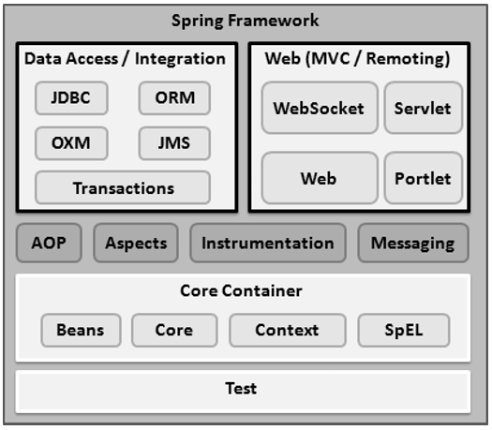
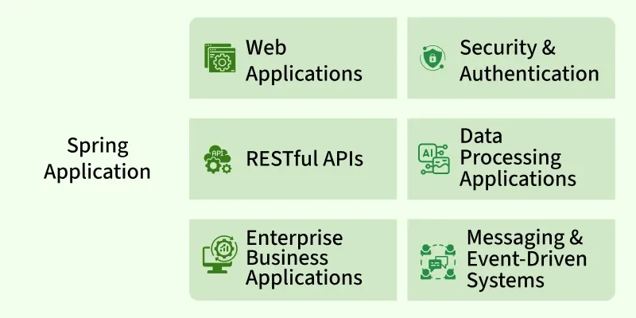
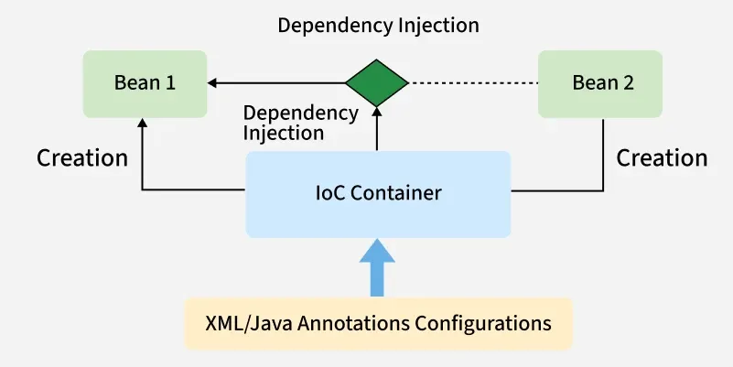
Spring Framework

Slide 11
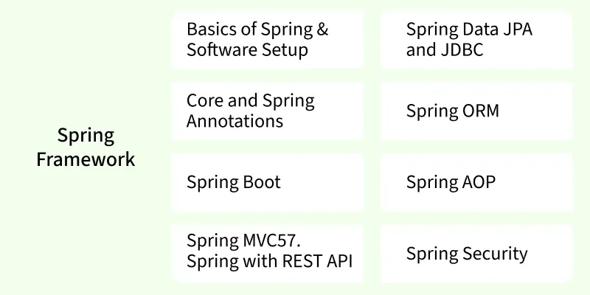
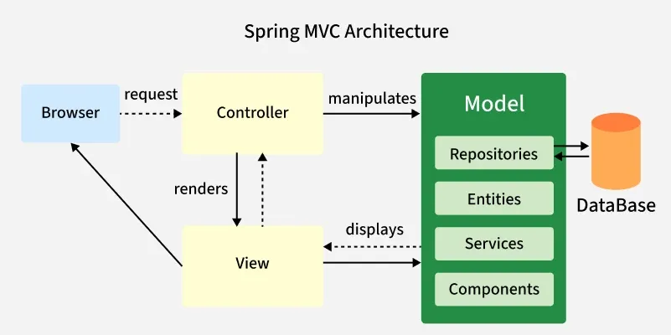

Slide 12
Applications of Spring Framework
Spring can be used to develop:
Web Applications (with Spring MVC)
RESTful APIs
Microservices (using Spring Boot & Spring Cloud)
Enterprise Applications
Batch Applications (Spring Batch)
Security-focused apps (with Spring Security)
Cloud-based apps (Spring Cloud integration with AWS, Azure, etc.)
Data-driven apps (with Spring Data JPA, JDBC)
Reason | Explanation
🔹 Loose Coupling | Through Dependency Injection
🔹 Fast Development with Spring Boot | Spring Boot reduces boilerplate code, auto-configuration
🔹 Huge Ecosystem | Covers everything from web to messaging to security
🔹 Community and Documentation | Strong community support and rich documentation
🔹 Testable and Maintainable | Built-in support for testing and clean architecture
🔹 Flexible Configuration | Supports annotations, XML, and Java-based configurations
🔹 Integration Ready | Works well with databases, Kafka, JMS, Hibernate, etc.

Slide 13
Why Spring Framework
Why Use Spring Framework (Core)
Dependency Injection (DI)
Allows automatic wiring of components, reducing tight coupling. Makes code more modular, reusable, and easier to manag
2. Inversion of Control (IoC)
Objects are created and managed by the Spring container. Promotes better control and flexibility in application design.
3. Aspect-Oriented Programming (AOP)
Separates cross-cutting concerns like logging, security, and transactions. Keeps business logic clean and focused.
4. Transaction Management
Provides a consistent way to manage transactions across different platforms. Supports both programmatic and declarative approaches (e.g., @Transactional).
5. Spring MVC
A web framework for building clean and maintainable web apps. Based on the Model-View-Controller (MVC) design pattern.
6. Integration Support
Easily integrates with JDBC, Hibernate, JMS, JPA, mail, and other technologies. Simplifies configuration and communication between different systems.

Slide 14
7. Flexible Configuration
Supports XML, annotation-based, and Java-based configurations. Developers can choose the approach that fits their project best.
8. Testability
Encourages writing POJOs that are easy to mock and test. Works well with testing frameworks like JUnit and Mockito.
9. Modular Architecture
You can use only the required modules like Core, AOP, or MVC. Helps keep the application lightweight and focused.
10. Enterprise-Ready
Proven in large, complex, and mission-critical applications. Backed by a large community and enterprise-level support.

Slide 15
Spring New Project
Tool | Description | Download Link
Java JDK (17+) | Required for compiling Java | https://adoptium.net/
IDE (IntelliJ / Eclipse / STS) | For writing and running code | IntelliJ: jetbrains.com Eclipse: eclipse.org
Maven or Gradle | Build tool (Spring Initializr handles this) | Usually included with IDE
Spring Boot | Framework for building Spring apps | Generated via Spring Initializr
Method | Best For | Tools Needed
Spring Initializr | Beginners & Fast setup | Browser
IntelliJ/Eclipse/STS | Developers using IDE | IntelliJ/Eclipse/STS
Manual Setup | Advanced customization (rare today) | Maven/Gradle
Spring CLI | Fast project setup from terminal | Spring CLI installed

Slide 16
Folder / File | Purpose
src/main/java | Main application source code
└── com.example.demo | Your base package (matches your group/artifact from Spring Initializr)
├── DemoApplication.java | Entry point for the Spring Boot app (@SpringBootApplication)
├── controller/ | Contains REST controllers (@RestController)
├── service/ | Business logic layer
├── repository/ | DAO layer (interfaces extending JpaRepository, etc.)
└── model/ or entity/ | Java classes representing database tables (entities)
src/main/resources/ | Contains configuration and static files
├── application.properties | Main config file for the project (DB, port, etc.)
├── static/ | Static files like CSS, JS, images (served automatically)
├── templates/ | Thymeleaf or other template files for web views
└── banner.txt | Custom banner shown on app startup (optional)
src/test/java/ | Unit and integration test classes
pom.xml / build.gradle | Dependency management and build file

Slide 17
Project Folder Imp
com.example.demo
├── controller // Handles HTTP requests
├── service // Business logic
├── repository // Database access
├── model // POJOs / Entities
├── dto // Data Transfer Objects (optional)
├── config // Configuration classes (security, beans)
└── DemoApplication.java
# Server config
server.port=8080
# Database config (e.g., MySQL)
spring.datasource.url=jdbc:mysql://localhost:3306/mydb
spring.datasource.username=root
spring.datasource.password=yourpassword
spring.jpa.hibernate.ddl-auto=update

Slide 18
Spring Annotations
3. What are Spring Annotations?
Spring Annotations are metadata used to define and configure Spring Beans without XML.
Annotation | Description
@Component | Generic stereotype for any Spring-managed bean
@Service | Marks business/service layer bean
@Repository | Marks DAO layer bean (also handles exceptions)
@Controller | Used in Spring MVC to handle web requests
@RestController | Combines @Controller + @ResponseBody
@Autowired | Automatically injects dependencies
@Configuration | Declares a configuration class
@Bean | Defines a bean in a config class
@Value | Injects values from properties file
@Service
public class UserService {
public String getUser() {
return "Vire More";
}
}

Slide 19
1. What is a Spring Bean?
A Spring Bean is simply a Java class/object that is managed by the Spring Container.
🔹 Key Points:
Beans are created, initialized, configured, and managed by Spring.
Beans are usually defined using annotations like @Component, @Service, @Repository, or in XML.
@Component
public class MyBean {
public void sayHello() {
System.out.println("Hello from Spring Bean!");
} }
2. What is Spring Container?
The Spring Container is the core part of the Spring Framework that is responsible for:
Creating objects (beans)
Managing dependencies (Dependency Injection)
Wiring beans together
Managing their life cycle
Container Type | Description
BeanFactory | Lightweight container; lazy loading
ApplicationContext | Most commonly used; supports advanced features (events, i18n)

Slide 20
Spring Container
The Spring Container is the core component of the Spring Framework that is responsible for creating, configuring, and managing the lifecycle of application objects, known as beans, using Dependency Injection (DI).
It uses Inversion of Control (IoC) — meaning the control of object creation is inverted from your code to the container.
It manages objects (called beans) in a Spring application.
It uses Inversion of Control (IoC) to inject dependencies automatically.
It reads configuration from Java classes, annotations, or XML files.
It provides a runtime environment for Spring-managed components.
Uses of Containers
In Any Spring-Based Application:
Spring Core (basic DI)
Spring MVC (web applications)
Spring Boot (microservices)
Spring Data JPA (repositories)
Spring Security (auth/security)
Reason | Description
Dependency Injection | Automatically wires dependencies between classes.
Loose Coupling | Promotes modular, testable, and maintainable code.
Centralized Configuration | Beans and services are configured in one place (XML, annotations, or Java config).
Lifecycle Management | Automatically manages object lifecycle (init, destroy, singleton/prototype).
AOP Integration | Makes it easy to apply cross-cutting concerns (logging, security, transactions).

Slide 21
Spring Application Context Container
ApplicationContext applicationContext=new ClassPathXmlApplicationContext("com/ConstructorInject/Test.xml");//xml Declaration
Book bookmain=(Book)applicationContext.getBean("bookinfo");//Bean Calling
Constructor injection
<bean id="bookinfo" class="com.ConstructorInject.Book">
<constructor-arg value="101" />
<constructor-arg value="java" />
</bean>
Setter inejction:
<bean id="empobj" class="com.setterinject.Emp">
<property name="eid">
<value>201</value>
</property>
<property name="empname">
<value>Saudagar More</value>
</property>
</bean>
Dependency Required
spring bean 6.2.6
context 6.2.6
core 6.2.6
expression 6.2.6
logging 1.2

Slide 22
difference between spring two basic container
ApplicationContext context = new AnnotationConfigApplicationContext(AppConfig.class);
MyBean bean = context.getBean(MyBean.class);
bean.sayHello();
Feature | BeanFactory | ApplicationContext
Initialization | Lazy (beans are created on first use) | Eager (beans are created at startup by default)
Performance | Slightly better for small apps | Preferred for enterprise-level applications
Event Handling | Not supported | Supported (ApplicationEventPublisher)
Internationalization (i18n) | Not supported | Supported
Auto Bean Registration | Not automatic | Supports auto-detection of beans (@ComponentScan)
Annotation Support | Limited or manual | Full annotation and Java config support
AOP and Features like Spring EL | Manual or limited | Fully supported
Used in Spring Boot? | Rarely used | Default in Spring Boot
✅ ApplicationContext is a superset of BeanFactory and is the preferred container in almost all modern Spring applications.

Slide 23
Why spring-context?
It includes all core modules needed for:
Bean creation
Setter and constructor injection
ApplicationContext
XML or annotation-based configuration
<beansxmlns="http://www.springframework.org/schema/beans"
xmlns:xsi="http://www.w3.org/2001/XMLSchema-instance"
xmlns:context="http://www.springframework.org/schema/context"
xsi:schemaLocation="http://www.springframework.org/schema/beans
http://www.springframework.org/schema/beans/spring-beans.xsd
http://www.springframework.org/schema/context
http://www.springframework.org/schema/context/spring-context.xsd">
What is Dependency Injection (DI) in Spring?
Dependency Injection is a design pattern used in Spring to achieve loose coupling between objects. Instead of a class creating its own dependencies, they are injected by the Spring container.
“Don't call us, we'll call you” — Instead of objects creating their dependencies, Spring injects them automatically.
Why Use Dependency Injection?
Promotes loose coupling
Improves testability
Supports modular and flexible design
Reduces boilerplate code
Type | Description
1️ Constructor Injection | Dependencies are passed via the constructor
2️ Setter Injection | Dependencies are set via public setter methods
3️ Field Injection | Dependencies are injected directly into fields using @Autowired

Slide 24
Constructor Injection
In Constructor Injection, Spring injects the dependencies through the class constructor at the time of bean creation.
@Component
public class CarService {
private final Engine engine;
// Constructor
@Autowired
public CarService(Engine engine) {
this.engine = engine;
}
}
Advantages
Immutable dependencies (can't change after creation)
Recommended by Spring (especially with @Autowired optional from Spring 4.3+)

Slide 25
Spring Setter Injection
Definition:
In Setter Injection, Spring injects the dependency using setter methods after the bean is constructed.
🔹 Example:
@Component
public class CarService {
private Engine engine;
// Setter method
@Autowired
public void setEngine(Engine engine) {
this.engine = engine;
}
}
Advantages
Useful for optional dependencies
Allows for reconfiguration after object creation

Slide 26
Field Injection
3. Field Injection
Definition:
In Field Injection, Spring injects the dependency directly into the field using @Autowired.
🔹 Example:
@Component
public class CarService {
@Autowired
private Engine engine;
}
Advantages:
Less boilerplate code
Very simple to use
Disadvantages:
Harder to test
Not recommended for production-level code (makes code less maintainable)
Injection Type | Injected Via | Best For | Pros | Cons
Constructor | Constructor | Mandatory dependencies | Immutable, testable | More code
Setter | Setter Method | Optional dependencies | Flexible, configurable | Mutable, can forget to call
Field | Field | Simple projects | Clean code | Harder to test, discouraged

Slide 27
Spring Autowiring
Autowiring in Spring is a feature that automatically injects dependencies into a Spring bean without needing to explicitly define them in the configuration file (like applicationContext.xml) or annotate them manually.
It tells Spring:
“Find the right bean that matches this dependency and inject it automatically.”
Concept | Annotation | Description
Component Scanning | @ComponentScan | Automatically detects beans
Bean Definition | @Component | Marks a class as a Spring bean
Constructor Injection | @Autowired on constructor | Injects dependency via constructor
Setter Injection | @Autowired on setter | Injects dependency via setter
1. @Autowired
The main annotation used for autowiring dependencies.
Annotation | Purpose
@Autowired | Automatically injects dependencies
@Component | Marks a class as a Spring-managed bean
@Qualifier | Specifies which bean to inject when multiple exist
@Primary | Marks one implementation as the default choice
@Value("someValue") injects values directly into fields.

Slide 28
Spring With Scope
In Spring Framework, scope defines how long a bean lives and how many instances of it are created. Here are the commonly used Spring bean scopes:
1. Singleton (default)
One instance per Spring container
The same bean is returned every time it is requested.
Most commonly used.
@Scope("singleton")
2. Prototype
A new bean instance is created every time it is requested.
Useful for stateful or short-lived objects.
@Scope("prototype")
3. Request (Web Applications)
One bean instance per HTTP request.
Only valid in a web-aware Spring application.
@Scope(value = WebApplicationContext.SCOPE_REQUEST)
session (used in spring web mvc
4. Session
One bean instance per HTTP session.
@Scope(value = WebApplicationContext.SCOPE_SESSION)

Slide 29
Spring With JDBC
What is JDBC?
JDBC (Java Database Connectivity) is an application programming interface (API) that defines how a client may access a database. It is a data access technology used for Java database connectivity. It provides methods to query and update data in a database and is oriented toward relational databases. JDBC offers a natural Java interface for working with SQL. JDBC is needed to provide a "Pure Java" solution for application development. JDBC API uses JDBC drivers to connect with the database.
Data Access using Spring JDBC Template
There are a number of options for selecting an approach to form the basis for your JDBC database access. Spring framework provides the following approaches for JDBC database access:
JdbcTemplate
NamedParameterJdbcTemplate
SimpleJdbcTemplate
SimpleJdbcInsert and SimpleJdbcCall
1. JDBC Template
JdbcTemplate is a central class in the JDBC core package that simplifies the use of JDBC and helps to avoid common errors. It internally uses JDBC API and eliminates a lot of problems with JDBC API. It executes SQL queries or updates, initiating iteration over ResultSets and catching JDBC exceptions and translating them to the generic. It executes core JDBC workflow, leaving application code to provide SQL and extract results. It handles the exception and provides the informative exception messages with the help of exception classes defined in the org.springframework.dao package.
The common methods of spring JdbcTemplate class:

Slide 30
DataSource in Spring
Spring doesn’t reinvent JDBC — it uses the standard javax.sql.DataSource interface.
In a Spring app, a DataSource bean is how you tell Spring how to connect to your database.
it is a standard Java interface (javax.sql.DataSource) provided by the JDBC API for establishing connections to a physical data source, such as a database. Spring, or any other framework that uses JDBC, relies on implementations of this interface to acquire database connections.
Once configured, this DataSource is
injected into components like:
JdbcTemplate
EntityManagerFactory (for JPA/Hibernate)
@Repository // detected by @ComponentScan
public class EmployeeDaoImpl implements EmployeeDao {
@Autowired
private JdbcTemplate jdbcTemplate;
@Override
public int save(Employee emp) {
String sql = "INSERT INTO employee (id, name, salary) VALUES (?, ?, ?)";
return jdbcTemplate.update(sql, emp.getId(), emp.getName(), emp.getSalary());
}
}

Slide 31
DriverManagerDataSource
DriverManagerDataSource is a simple implementation of the DataSource interface that does not provide connection pooling.
public class DriverManagerDataSource extends AbstractDriverBasedDataSource. Simple implementation of the standard JDBC DataSource interface, configuring the plain old JDBC DriverManager via bean properties, and returning a new Connection from every getConnection call.
It’s mainly used for:
Testing or local development
Small apps that don’t need high performance
@Bean
@Repository
@Configuration
@ComponentScan(basePackages = "com.example") // will detect @Repository classes
public class AppConfig {
@Bean
public DataSource dataSource() {
DriverManagerDataSource ds = new DriverManagerDataSource();
ds.setDriverClassName("com.mysql.cj.jdbc.Driver");
ds.setUrl("jdbc:mysql://localhost:3306/testdb");
ds.setUsername("root");
ds.setPassword("root");
return ds;
}
@Bean
public JdbcTemplate jdbcTemplate(DataSource ds) {
return new JdbcTemplate(ds);
}
}

Slide 32
public Map<String,Object> fetchByIdAsMap(int id);
public List<Map<String,Object>> FetchAllDetails();
@Override
public Map<String, Object> fetchByIdAsMap(int id) {
return jdbcTemplate.queryForMap("select * from book where bid=?" , id);
}
@Override
public List<Map<String, Object>> FetchAllDetails() {
return jdbcTemplate.queryForList("select * from book");
}
Map<String, Object> productData = bookDao.fetchByIdAsMap(1);
int id = (int) productData.get("bid");
List<Map<String, Object>> bookdata=bookDao.FetchAllDetails();
for(Map<String, Object> data:bookdata) {
int id = (int) data.get("bid");
}

Slide 33
Spring MVC
Sprin MVC is Sub Framework of Java. Spring MVC is a web framework within the Spring Framework that follows the Model–View–Controller (MVC) architectural pattern. It’s used to build Java-based, flexible, testable, and loosely coupled web applications.
Spring MVC (Model-View-Controller) is a part of the Spring Framework used to build web applications (including REST APIs).
It separates an application into three layers:
How Spring MVC Works (Request Flow)
Client sends a request → /users/list
Request goes to DispatcherServlet (front controller)
DispatcherServlet uses HandlerMapping to find the correct controller
Controller processes the request and returns a ModelAndView
DispatcherServlet sends the model to ViewResolver
ViewResolver selects the right view (e.g., JSP/Thymeleaf)
View is rendered and returned to the user
Model: Represents data (like Java classes or database entities).
View: Represents UI (like JSP, Thymeleaf, HTML).
Controller: Handles HTTP requests and business logic.
Spring MVC follows the classic request-response model using DispatcherServlet.

Slide 34
Spring MVC Architecture
Here's how a Spring MVC request flows:
[Client] → [DispatcherServlet] →
[Controller] → [Service] → [DAO]
↓
[ViewResolver]
↓
[View (JSP/HTML)]
Advantages of Spring MVC Framework
Uses a lightweight servlet container for the development and deployment of applications.
Enables rapid and parallel development.
Facilitates fast application development.
Allows multiple developers to work together efficiently.
Makes updating the application easier.
Enhances debugging due to multiple levels in the application.
Disadvantages of Spring MVC Framework
It has high complexity when developing applications using this pattern.
It is not suitable for small applications as it may affect performance and design.

Slide 35
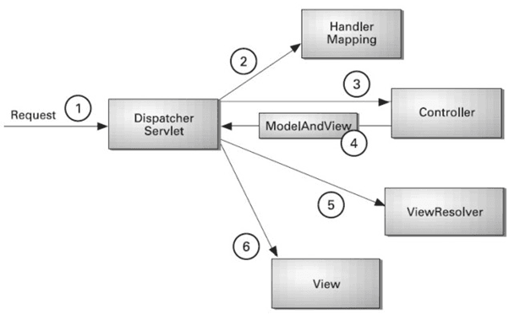
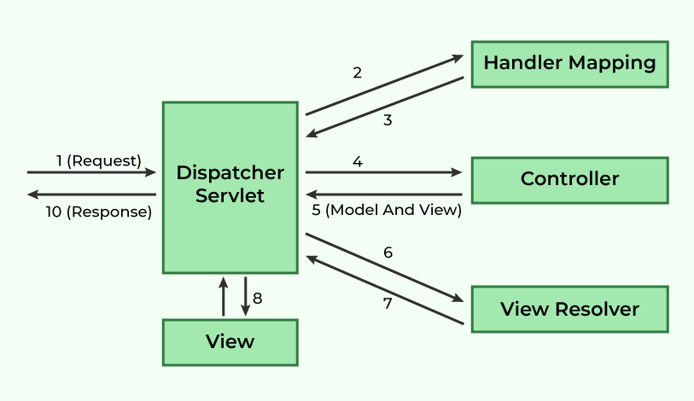
DispatcherServlet
The DispatcherServlet is the central component of Spring MVC:
Acts as the Front Controller for all HTTP requests.
Determines the appropriate controller to handle a request.
Dispatches the request to the selected controller.
Resolves the view using the View Resolver and renders the response.
DispatcherServlet intercepts incoming requests.
Retrieves the handler mapping and forwards the request to the controller.
The controller processes the request and returns a ModelAndView object.
DispatcherServlet uses the view resolver to render the appropriate view.

Slide 36
spring Mvc Dependency for pom.xml
<dependencies>
<!-- Spring Web MVC -->
<dependency>
<groupId>org.springframework</groupId>
<artifactId>spring-webmvc</artifactId>
<version>5.3.30</version>
</dependency>
<!-- Jakarta Servlet API -->
<dependency>
<groupId>jakarta.servlet</groupId>
<artifactId>jakarta.servlet-api</artifactId>
<version>5.0.0</version>
<scope>provided</scope>
</dependency>
</dependencies>
Web.xml
<web-app>
<display-name>SpringMVC</display-name>
<servlet>
<servlet-name>spring</servlet-name>
<servlet-class>org.springframework.web.servlet.DispatcherServlet
</servlet-class>
<load-on-startup>1</load-on-startup>
</servlet>
<servlet-mapping>
<servlet-name>spring</servlet-name>
<url-pattern>/</url-pattern>
</servlet-mapping>
</web-app>

Slide 37
spring-servlet.xml
<beans xmlns="http://www.springframework.org/schema/beans"
xmlns:context="http://www.springframework.org/schema/context"
xmlns:mvc="http://www.springframework.org/schema/mvc"
xmlns:xsi="http://www.w3.org/2001/XMLSchema-instance"
xsi:schemaLocation="http://www.springframework.org/schema/beans
http://www.springframework.org/schema/beans/spring-beans.xsd
http://www.springframework.org/schema/context
http://www.springframework.org/schema/context/spring-context.xsd
http://www.springframework.org/schema/mvc
http://www.springframework.org/schema/mvc/spring-mvc.xsd">
<context:component-scan base-package="com.Test.controller"/>
<mvc:annotation-driven/>
<bean class="org.springframework.web.servlet.view.InternalResourceViewResolver">
<property name="prefix" value="/WEB-INF/views/"/>
<property name="suffix" value=".jsp"/>
</bean>
</beans>

Slide 38
viewResolver
ViewResolver is an interface in Spring MVC whose job is to resolve view names into actual view files (JSP, Thymeleaf, HTML, etc.).
InternalResourceViewResolver is a class,InternalResourceViewResolver is a Spring MVC view resolver used mainly for JSP views. It resolves logical view names (returned by controllers) to actual JSP files located inside a configured folder.
This resolver works with JSP files and uses InternalResourceView or JstlView.
return "home";
/WEB-INF/views/home.jsp
what is prefix and suffix
Spring MVC, the prefix and suffix in a ViewResolver (like InternalResourceViewResolver) are used to build the full path of a view file (such as a JSP) based on the logical view name returned from a controller.
The prefix is the folder path where your view files are located.
resolver.setPrefix("/WEB-INF/views/");
The suffix is the file extension of your view files.
resolver.setSuffix(".jsp");
prefix + viewName + suffix / /WEB-INF/views/ + home + .jsp

Slide 39
@Controller
public class HomeController {
@RequestMapping("/")
public String home() {
return "index";
}
method=Requestmethod.post
@requestparam(“name”) String name;
model.attattribute(“name”,name)

Slide 40
Spring MVC Annotation
Component | Role
DispatcherServlet | Main front controller that handles all HTTP requests
Controller--- | Java class to handle request methods
ViewResolver | Decides which view (HTML/JSP) to render
Model | Contains data passed from controller to view
HandlerMapping | Maps URL patterns to controller methods
Annotation | Description
@Controller | Marks a class as a Spring MVC controller
@RestController | Combines @Controller + @ResponseBody
@RequestMapping | Maps URLs to methods (GET, POST, etc.)
@GetMapping, etc. | Shortcuts for HTTP methods (GET, POST, etc.)
@ModelAttribute | Binds form values to model objects
@PathVariable | Binds URL segments to method parameters
@RequestParam | Binds request query parameters
@ResponseBody | Sends return value directly as response

Slide 41
java Based Configuration
Component | Purpose
WebAppInitializer | Replaces web.xml; initializes Spring MVC
WebConfig | Java-based Spring MVC config
@EnableWebMvc | Enables MVC defaults
@ComponentScan | Finds controllers
ViewResolver | Maps return strings to JSP pages
public class MyWebAppInitializer implements WebApplicationInitializer {
@Override
public void onStartup(ServletContext container) throws ServletException {
AnnotationConfigWebApplicationContext context = new AnnotationConfigWebApplicationContext();
context.register(WebConfig.class);
ServletRegistration.Dynamic dispatcher =
container.addServlet("dispatcher", new DispatcherServlet(context));
dispatcher.setLoadOnStartup(1);
dispatcher.addMapping("/");
}
}
@Configuration
@EnableWebMvc
@ComponentScan(basePackages = "com.example")
public class WebConfig implements WebMvcConfigurer {
@Override
public void configureViewResolvers(ViewResolverRegistry registry) {
InternalResourceViewResolver resolver = new InternalResourceViewResolver();
resolver.setPrefix("/WEB-INF/views/");
resolver.setSuffix(".jsp");
registry.viewResolver(resolver);
}
}

Slide 42
Dependencies for spring java based configuration
<dependencies>
<!-- Spring MVC -->
<dependency>
<groupId>org.springframework</groupId>
<artifactId>spring-webmvc</artifactId>
<version>5.3.39</version>
</dependency>
<!-- Servlet API -->
<dependency>
<groupId>jakarta.servlet</groupId>
<artifactId>jakarta.servlet-api</artifactId>
<version>5.0.0</version>
<scope>provided</scope>
</dependency>
</dependencies>

Slide 43
What is @ModelAttribute in Spring MVC?
<% page isELIgnored=”false” %>
@ModelAttribute is an annotation used in controllers to:
1 Bind form data (HTTP request parameters) to a Java object
2 Add that object to the Model so it can be used in the View (JSP/HTML)
3 Pre-populate common data for all controllers (optional)
1. To automatically bind form data to a Java bean
Instead of writing:
String name = request.getParameter("name");
int age = Integer.parseInt(request.getParameter("age"));
public String save(@ModelAttribute User user)
Spring will fill the User object automatically using form field names.
2. To reduce boilerplate (less code)
It avoids manual parsing and request handling.
3. To pass model data to the view automatically
Any @ModelAttribute object is placed into the model so JSP/HTML can access it.
4. To provide common data for multiple pages
You can use @ModelAttribute on a method to add data to the model before every request handler runs.

